Slide 1
Mockup Dashboard DS4A – Group 35
9 Noviembre 2019

Slide 2
HEATMAP BOGOTÁ REAL STATE PRICES
DRAG & DROP
INTERACTIVE PLOTS
FILTERS

Slide 3
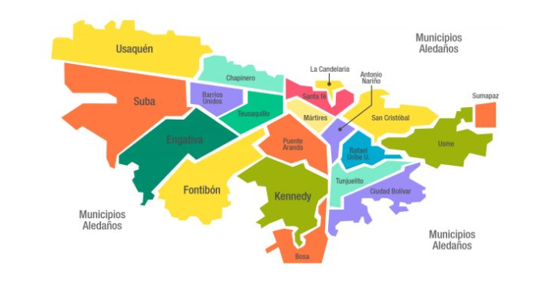
DEEP DIVE HEATMAP BOGOTÁ REAL STATE PRICES
Map of Bogotá divided by the biggest zone division (Localidades). It Will show the average price of real state when the cursor is over each division. When user clicks it will make a close-up, explained in the next slide

Slide 4
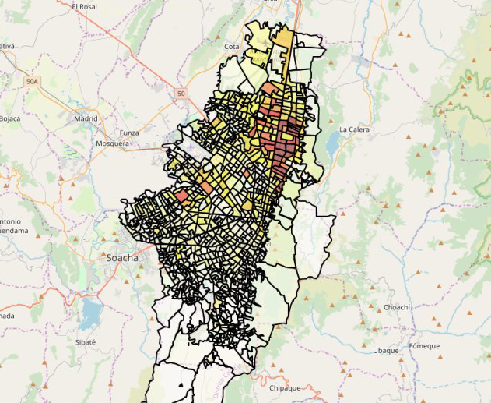
DEEP DIVE HEATMAP BOGOTÁ REAL STATE PRICES
2. Map of Bogotá with the close-up of the selected “localidad” in step 1. It will show the average price of real state, when the cursor is over the selected zone

Slide 5
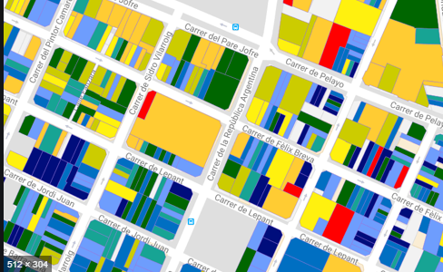
DEEP DIVE HEATMAP BOGOTÁ REAL STATE PRICES
3. Detailed information of the selected zone, with data points of real state offers and the relevant information with the variables that we find out are more sensible to the price

Slide 6
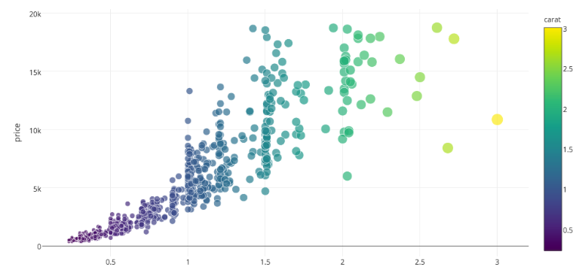
DEEP DIVE INTERACTIVE PLOTS
1. User will have the option to select the desired independent variable (x axis in the plot). Depending on how specific the user is at this point (How many filters has selected) the information will have less variation. Variables will be number of rooms, number of bathrooms, specific information about the real state
Variable 1
Variable 2
Variable 3
Variable 4

Slide 7
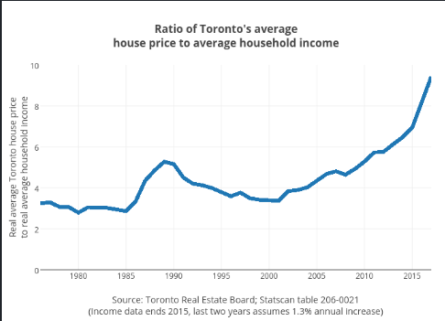
DEEP DIVE INTERACTIVE PLOTS
2. This plots will be interactive with the location that the user is going to select in the first chart (The heatmap)
Variable 1
Variable 2
Variable 3
Variable 4

Slide 8

DRAG & DROP
User will select and drop the infrastructure icons over the heatmap chart. The price will change upon the sensibility of itself with the new information

Slide 9
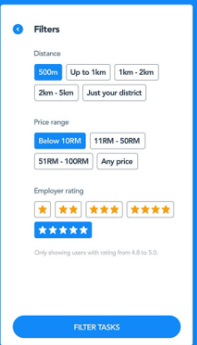
FILTERS
Very general filters for the user to refine the search. This general filters could include the social stratum, type of building, etc

